Slide 1
Increase Enrollment in My HealtheVet (MHV) Sprint 2 Demo 1
October 20, 2014
Notes:
Presented by:
Don Michalak, PMP, CSM
New Models of Health Care, OED
Albany, OIFO
518-449-0242 (office)
Feel free to use all or some of this presentation but give credit to the appropriate source and authors to avoid any copyright issues.

Slide 2
Sprint 2 Demo – User Stories
Add/Display VistA MHV Enrollment questions screen
As a VistA user, during pre-registration of a Patient, I want to capture the Patient's status with each of the three MHV enrollment questions so that this is documented and accessible the next time the Patient record is accessed.
Alert
Socialization
Enrollment Fields
Select Patient
Preregistration
if “N” for less than 6 months (not fully implemented as of 10.20.2014)

Slide 3
IEMHV ENROLLMENT FIELD DECISION TREE – Demo Path
Enrollment Status (1. to edit, <RET> to continue)
4.
Continue
<RET>
entered
Enrolled:
Authenticated:
Secure Messaging:
1. entered
Enrolled (Y/N)
Yes
No
1.
Authenticated (Y/N/A)
Reason Code
Patient Message
Enrollment Status
Yes
No
Action
2B.
2A.
Opted-in(Y/N/A)
Reason Code
Action list
Other
Yes
No
Action
Enrollment Status
3B.
3A.
Enrollment
Status
Reason Code
Action list
Bring id
Patient Message¹ - “Upgrade to a Premium MHV account to view parts of your VA health record. This requires one-time in-person identity verification (show photo ID). Read and sign this Release of Information form (10-5345a-MHV.) ”
Enrollment Status
Notes:
Number boxes indicate demo paths followed and sequence.

Slide 4
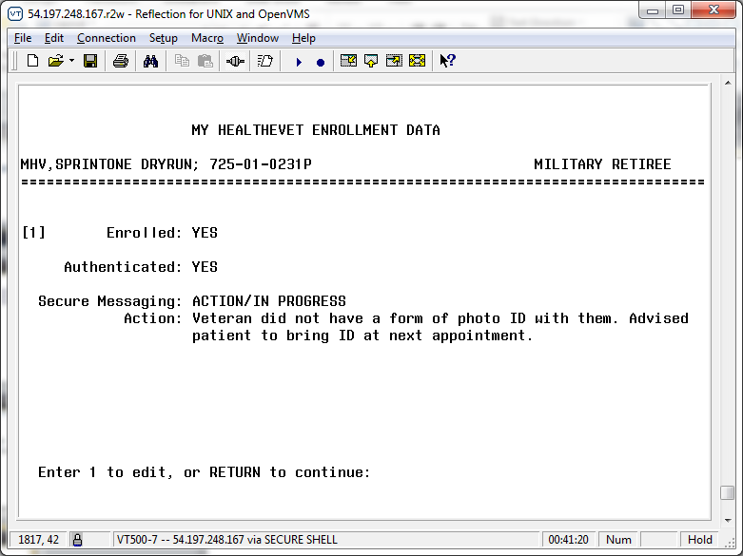
Enrollment Fields Sample Enrollment Status Screen

